Slide 1
TP 3
Article Presentation

Slide 2
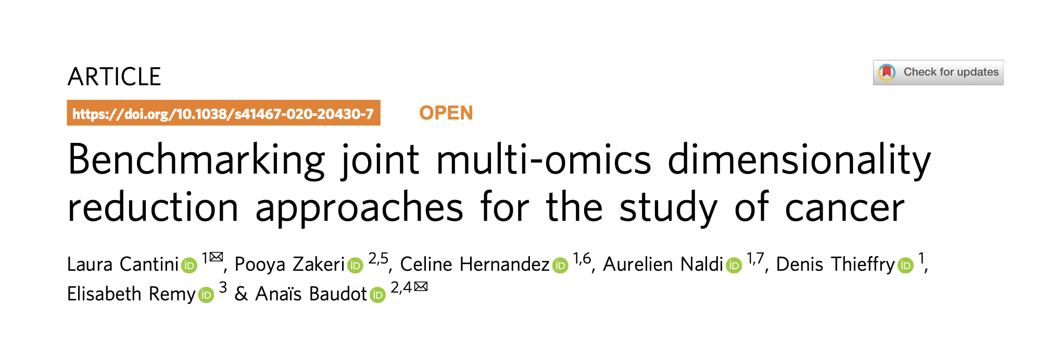
Articles
About joint Dimensionality Reduction (jDR) methods
Complete benchmark with simulated data, TCGA data and Single cell data

Slide 3
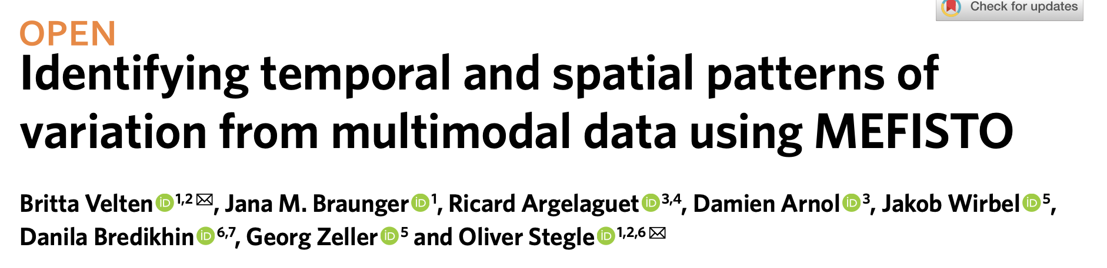
Articles
Factor Analysis
Modeling high-dimensional data
Spatial and temporal data
Application on organ development, microbiome study, single-cell multi-omics atlas of mouse gastrulation and spatially resolved transcriptomics.

Slide 4
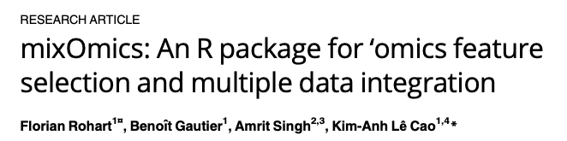
Articles
Multivariate analysis of biological data sets
Projection to Latent Structure (PLS) models for discriminant analysis, for data integration across multi-omics data and for the identification of molecular signatures.

Slide 5
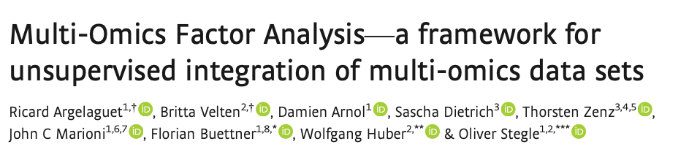
Articles
Factor Analysis
Identification of common factors that drive variability across different data modalities, allowing researchers to uncover hidden patterns and relationships.

Slide 6
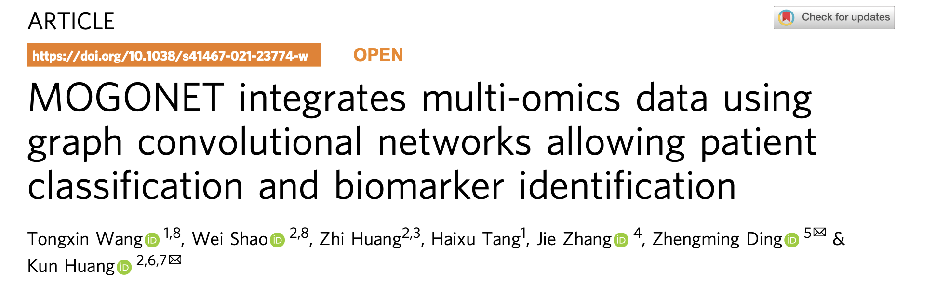
Articles
Graph Convolutional Network (GCNs)
Supervised multi-omics integrative analysis approach
Omics-specific learning and cross-omics correlation learning for multi-omics data classification

Slide 7
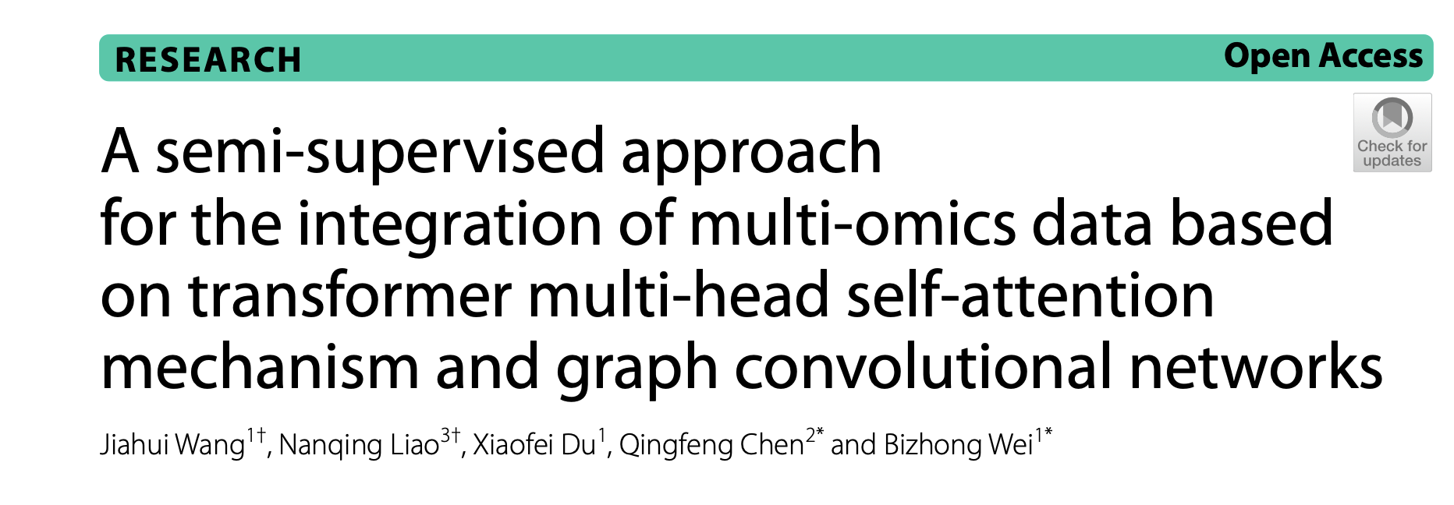
Articles
Transformers, Similarity Network Fusion (SNF) and Graph Convolutional Network (GCNs)
Semi-supervised multi-omics integrative analysis approach
Learn the inherent correlations of latent features within and among different omics and feeds this learned information into a GCN.
Applications on Alzheimer disease and breast cancer

Slide 8
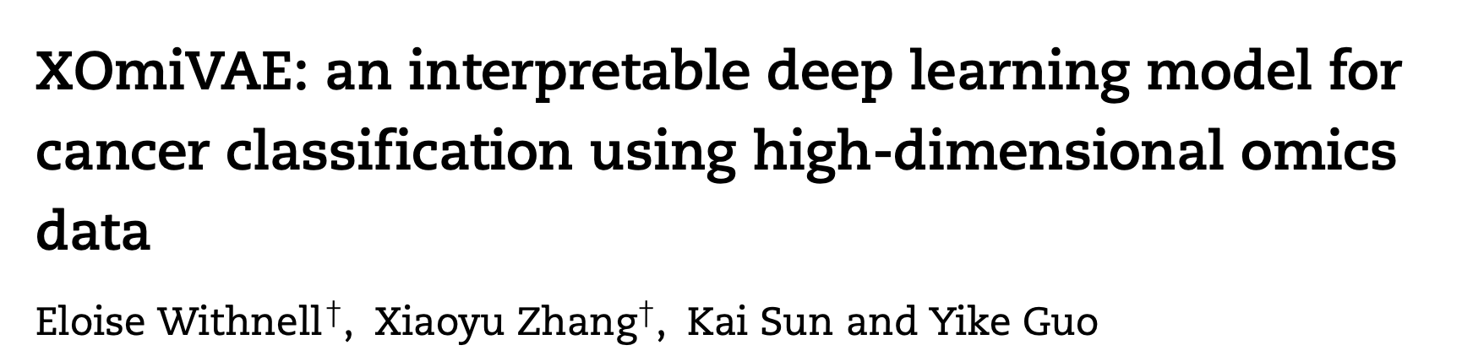
Articles
Variational autoencoder (VAE)-based interpretable deep learning model for cancer classification using high-dimensional omics data.
Reveal the contribution of each gene and latent dimension for each classification prediction and the correlation between each gene and each latent dimension.

Slide 9
Instructions
Prepare an oral presentation explaining the article of your choice
The oral presentation should follow this outline:
2 slides for Introduction
2/3 slides explaining the method
2/3 slides showing the 2/3 most important results
2 slides for conclusion/discussion
Presentation time : 10/15 minutes

